Slide 1
Platform – Dependency Viewer

Slide 2
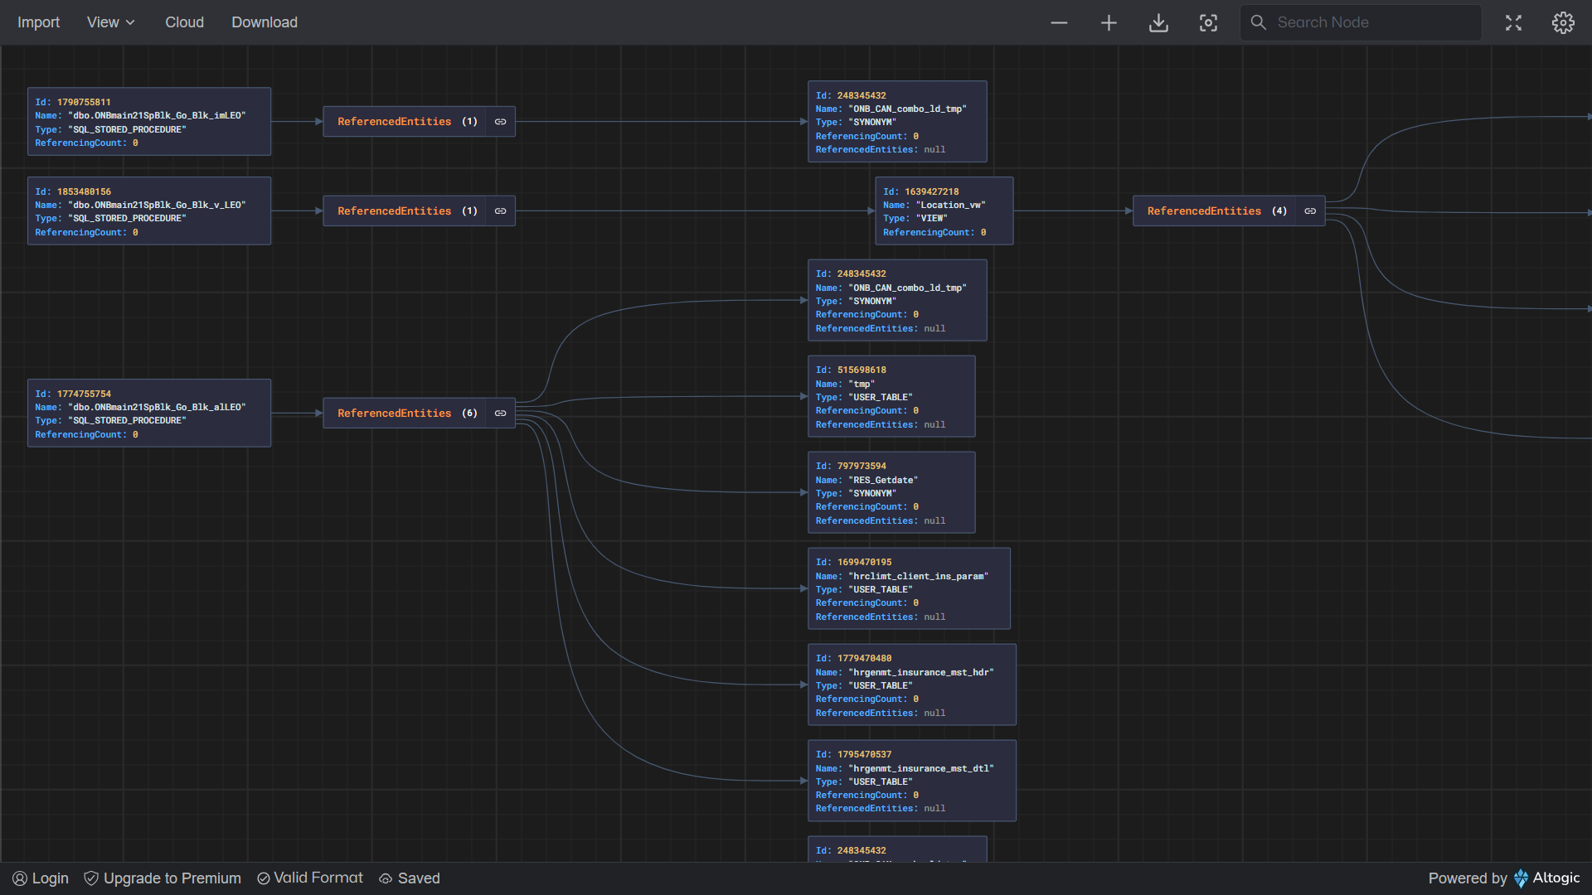
Platform – Dependency Viewer
A comprehensive graphical representation provided to visualize dependency object tree between modeled stored procedures and the associated application backend objects.
Dependent entity types are
Stored Procedures
Functions
Tables
View
Synonym
The current scope is limited to the primary database exclusively. Entities spanning across multiple databases and servers are not addressed in this release.
Only method sps is handled. Integration service to be planned

Slide 3
Platform – Dependency Viewer
Launching Applications
1. Platform model - Generate service screen
2. QA Review dashboard
Usage Scenarios
1. Impact analysis - facilitating for identification of application objects associated with a given service
2. Static code analysis
Dependency Viewer

Slide 4
Graph Viewer Capabilities
Zoom Out & Zoom In
Search text in graph nodes
Fullscreen mode
Rotate Layout – default orientation is horizontal
Expand / collapse nodes
Export data in JSON format

Slide 5
Platform – Dependency Viewer
Planned Features (In-progress)
Dependency tree for Integration service
Reverse impact analysis (Referencing entities) involves retrieving all the referencing entities and impacted services for a specified application backend object
Deployment Prerequisite
VirtualWorks RT Release 2.10.0.0
VwApie RT Release 3.1.26

Slide 6
Platform – Dependency Viewer – Fullscreen

